Slide 1
Watch server
Using Express Framework

Slide 2
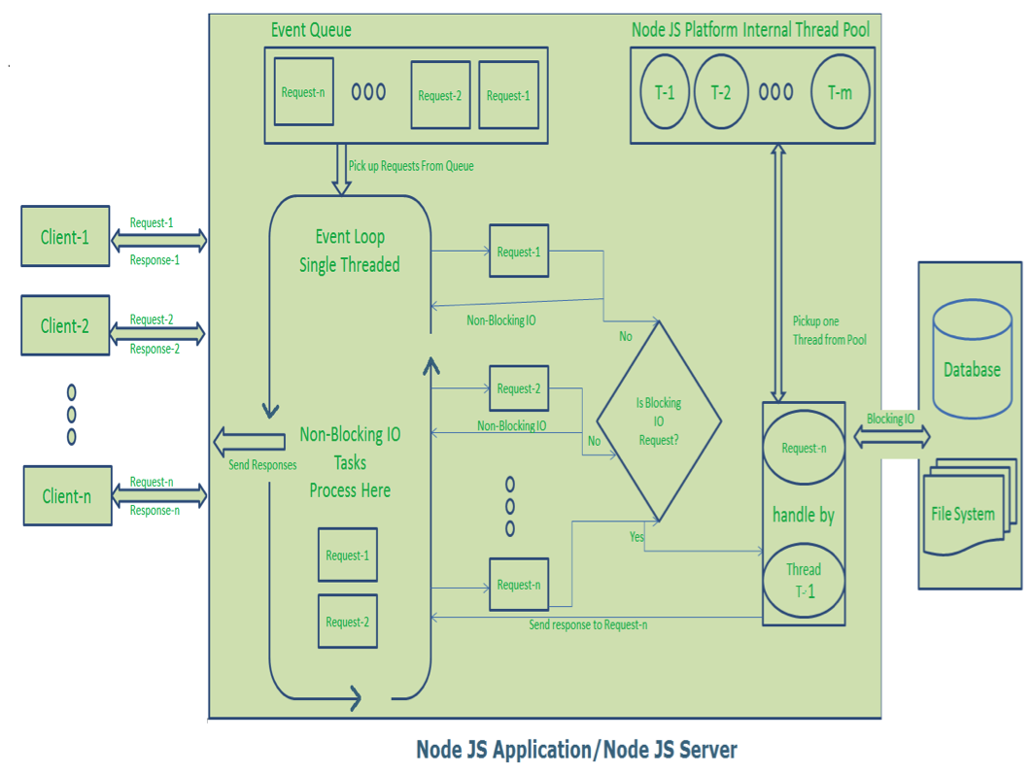
NodeJS fundamentals

Slide 3
Server Architecture
addwatch API
currtime API
Cookie
stop method
start method
Express sessions
Client
startwatch API
Stop Watch Class
stopwatch API
showlap API

Slide 4
deployment
The server deployed in heroku cloud
https://murmuring-reef-67170.herokuapp.com/

